Slide 1
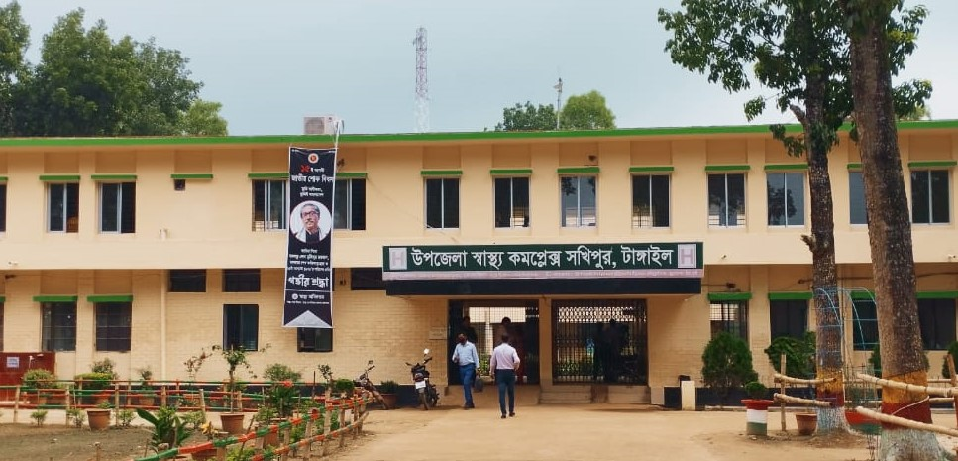
50 BEDDED UPAZILA HEALTH COMPLEX
SAKHIPUR, TANGAIL.

Slide 2
A Hospital with a Vision …
Maximum utilization of Govt.
resources with
honesty and sincerity.
Integrated approach of
Administration, Community
Leaders .
Providing Effective services
through improved
management system.

Slide 3
Background
Shakhipur health complex established in 1982.
New building established in 2004.
C-section started in …….
NCD corner started in ……..
SSK started in 2022.

Slide 4
Health Profile of Sakhipur Upazila- 2021
Total population : 281720
Total Fertile Couples : 7050
Total Pregnant : 7250
Total Delivery : 6112
Total Live birth : 5822
Total death : 1026
Total Maternal death : 06
Health Man power
a. Doctor : 19 ( 11 + 8)
b. Nurse : 32
c. HA : 35
d. SBA : 32( 10HA+ 16 FWA 6 CHCP )
e. Volunteer, Security guard & cleaner: 20
9. Health Institutions
a. Health Complex : 01
b. H & FWC : 9 (RD- 4 + FWC– 5 )
c. Community clinic : 37
d. Non- Govt. Clinic : 8

Slide 5
10. Mother Taken-ANC : 85% ( 1st Visit)
11. Hospital Delivery Rate : 60%
12. Total C. Section rate : 35%
13. No. of Hospital bed : 50
14. CPR
15. TFR
16. Immunization coverage Rate
17. Bed Occupancy Rate : 100%
18. Maternal Mortality Ratio : 42 / 100000 live Birth
19. Neonatal Mortality Rate : 16.7 / 1000 live birth
20. Infant Mortality Rate : 20.6 /1000 live birth
21. Under-5 Mortality Rate : 22.7 /1000 live birth

Slide 6

Shakhipur UHC
Bed Occupancy Rate from 2017 to 2022

Slide 7
No. of patient in Emergency + Out Door and Indoor Service
2017 to September 2022
Shakhipur UHC

Slide 8
Shakhipur UHC
EOC Activities : 2017- 2022
(Hospital Delivery and C-Section)

Slide 9
Shakhipur UHC
ANC Care: 2017 to July 2022
(ANC 1st and 4th Visit)
Please add
data of Shakhipur UHC

Slide 10
Comparative data of revenue income (in Taka) from 2015 to 2017 (????)
Shakhipur UHC

Slide 11
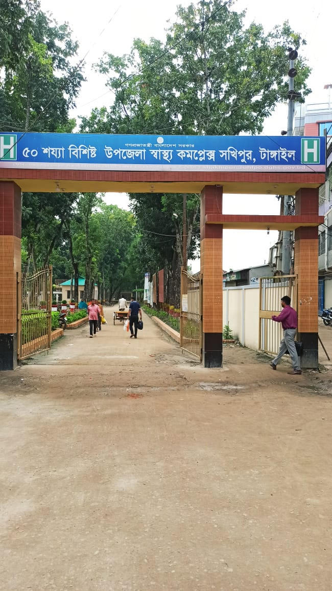
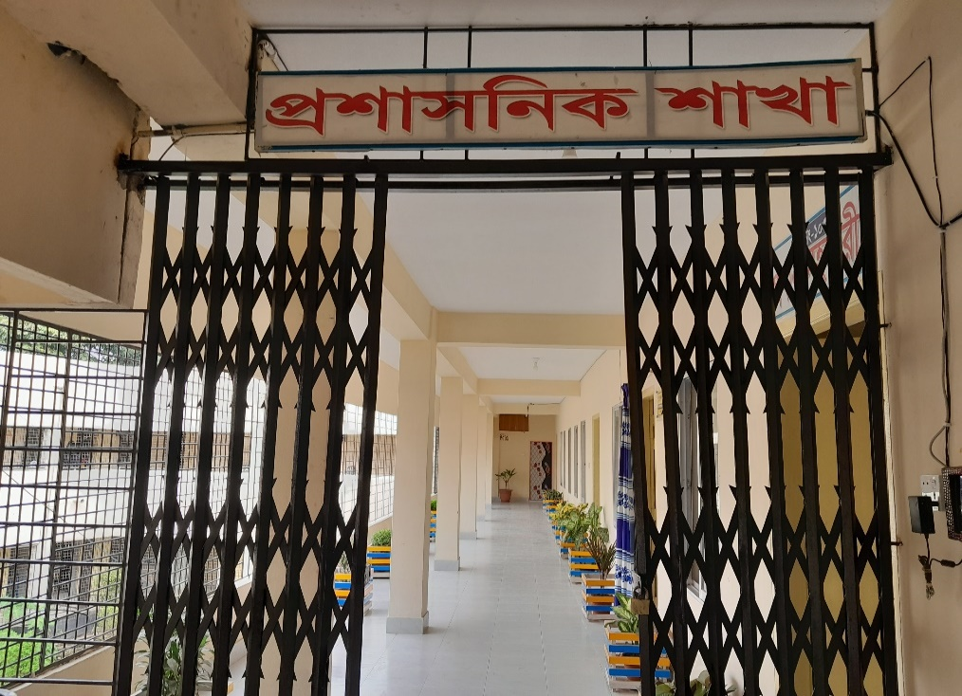
Attractive Front Gate and Administrative Wing
Front Gate of the hospital
Administrative wing

Slide 12
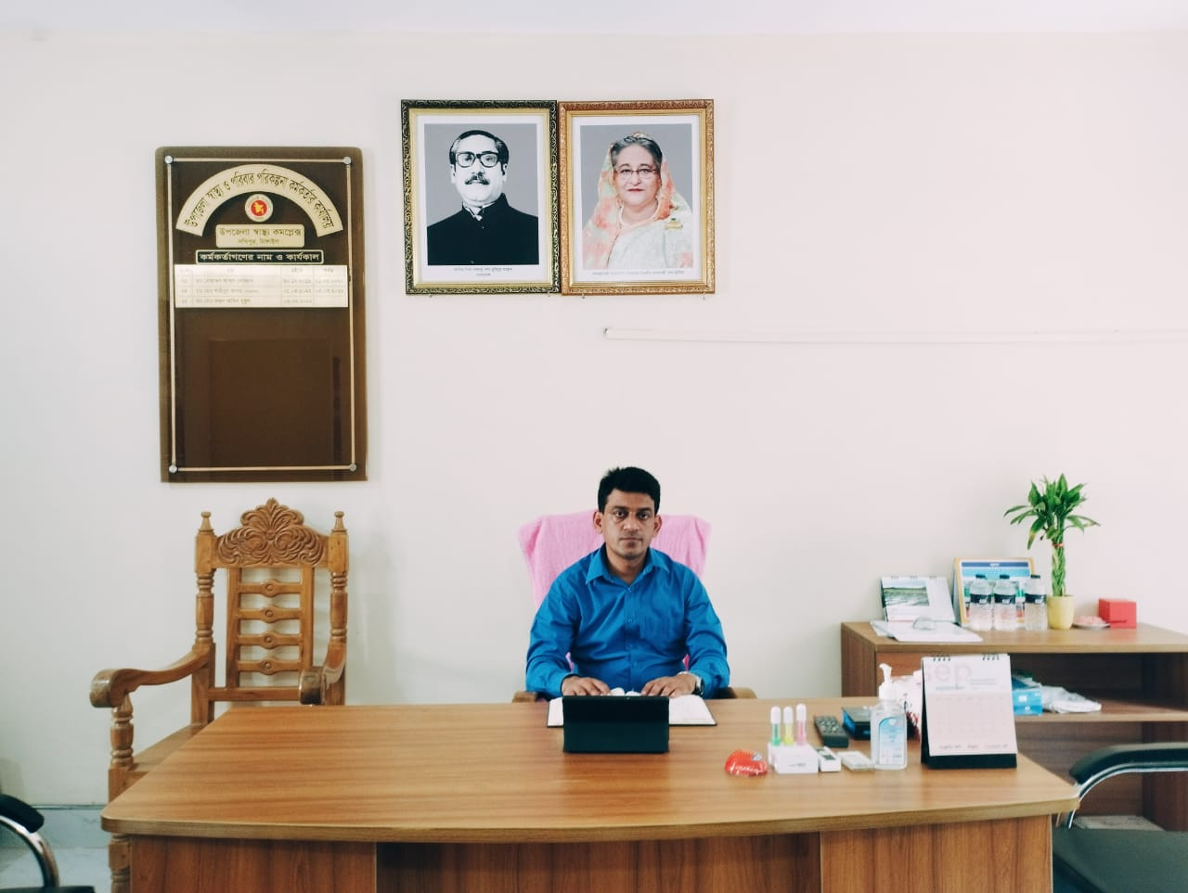
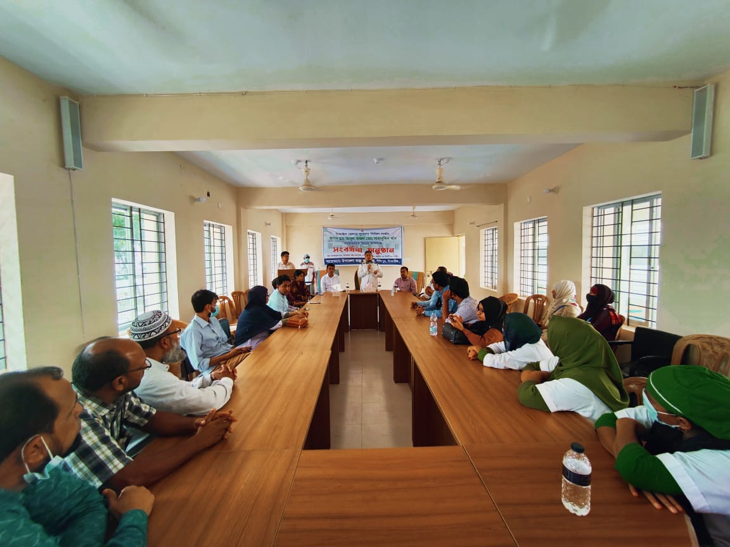
UH&FPO Room and Conference Room
UH&FPO Room
Conference Room

Slide 13
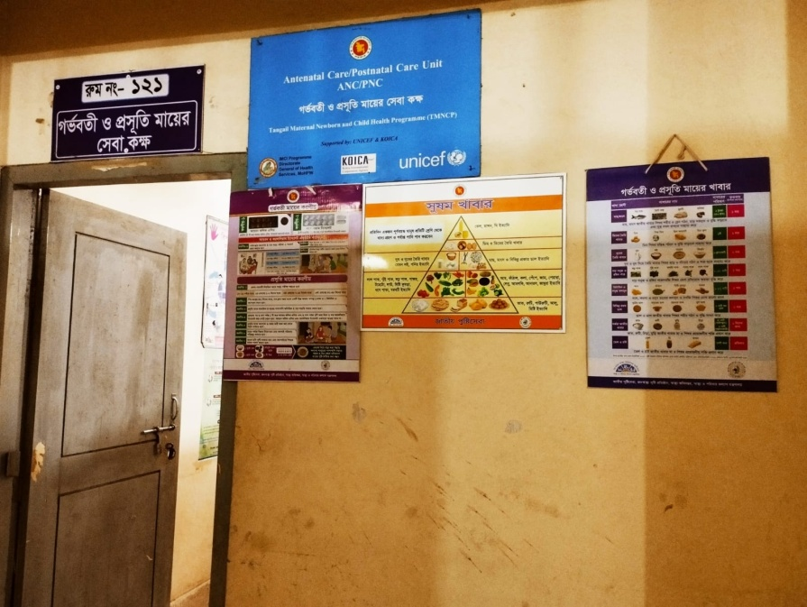
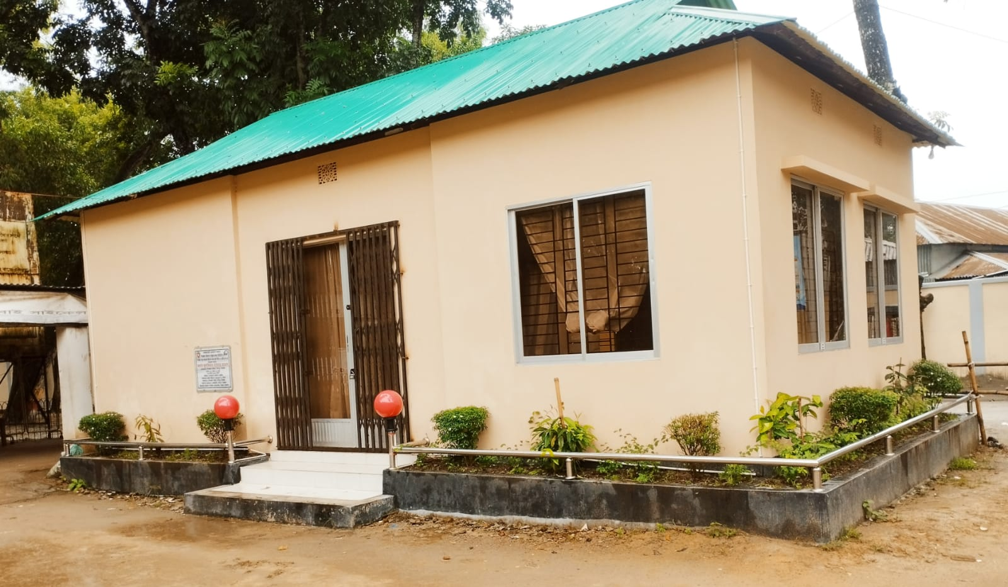
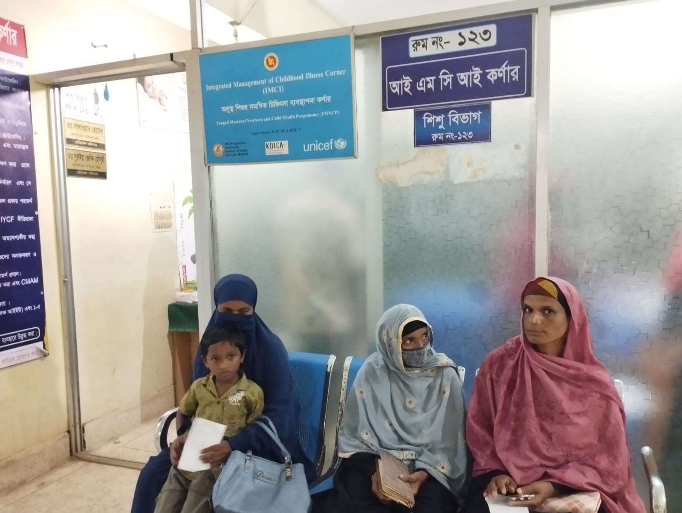
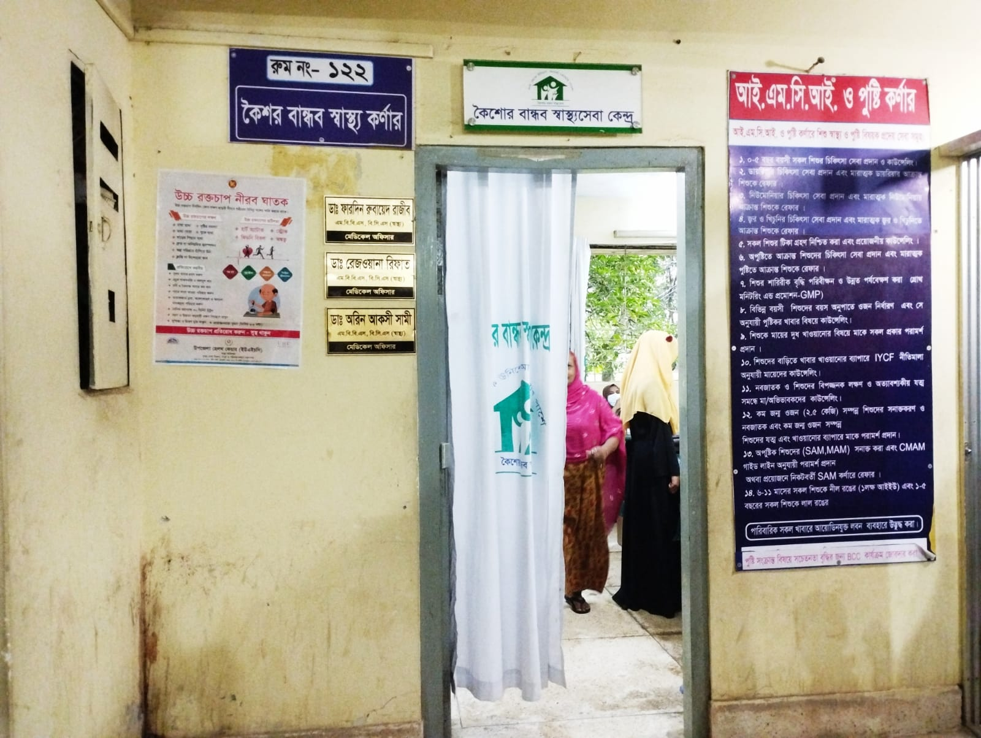
Different corner
ANC-PNC corner
Breast feeding corner
IMCI corner
Adolescence corner

Slide 14
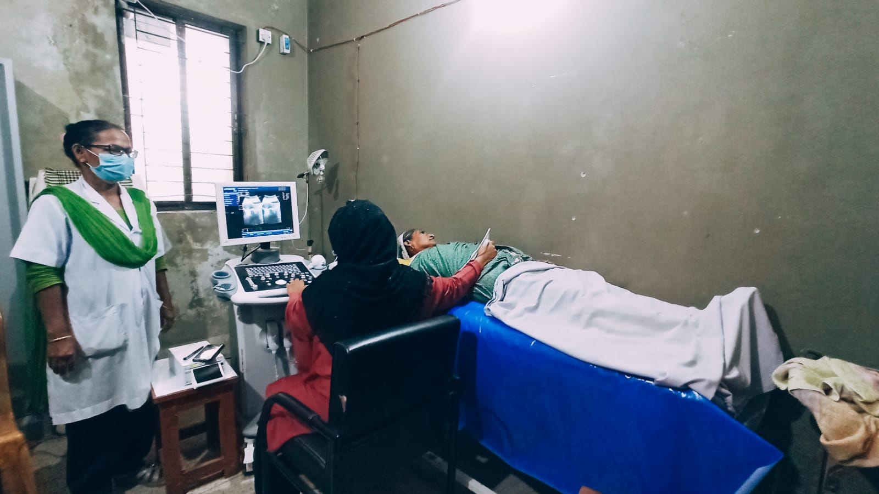
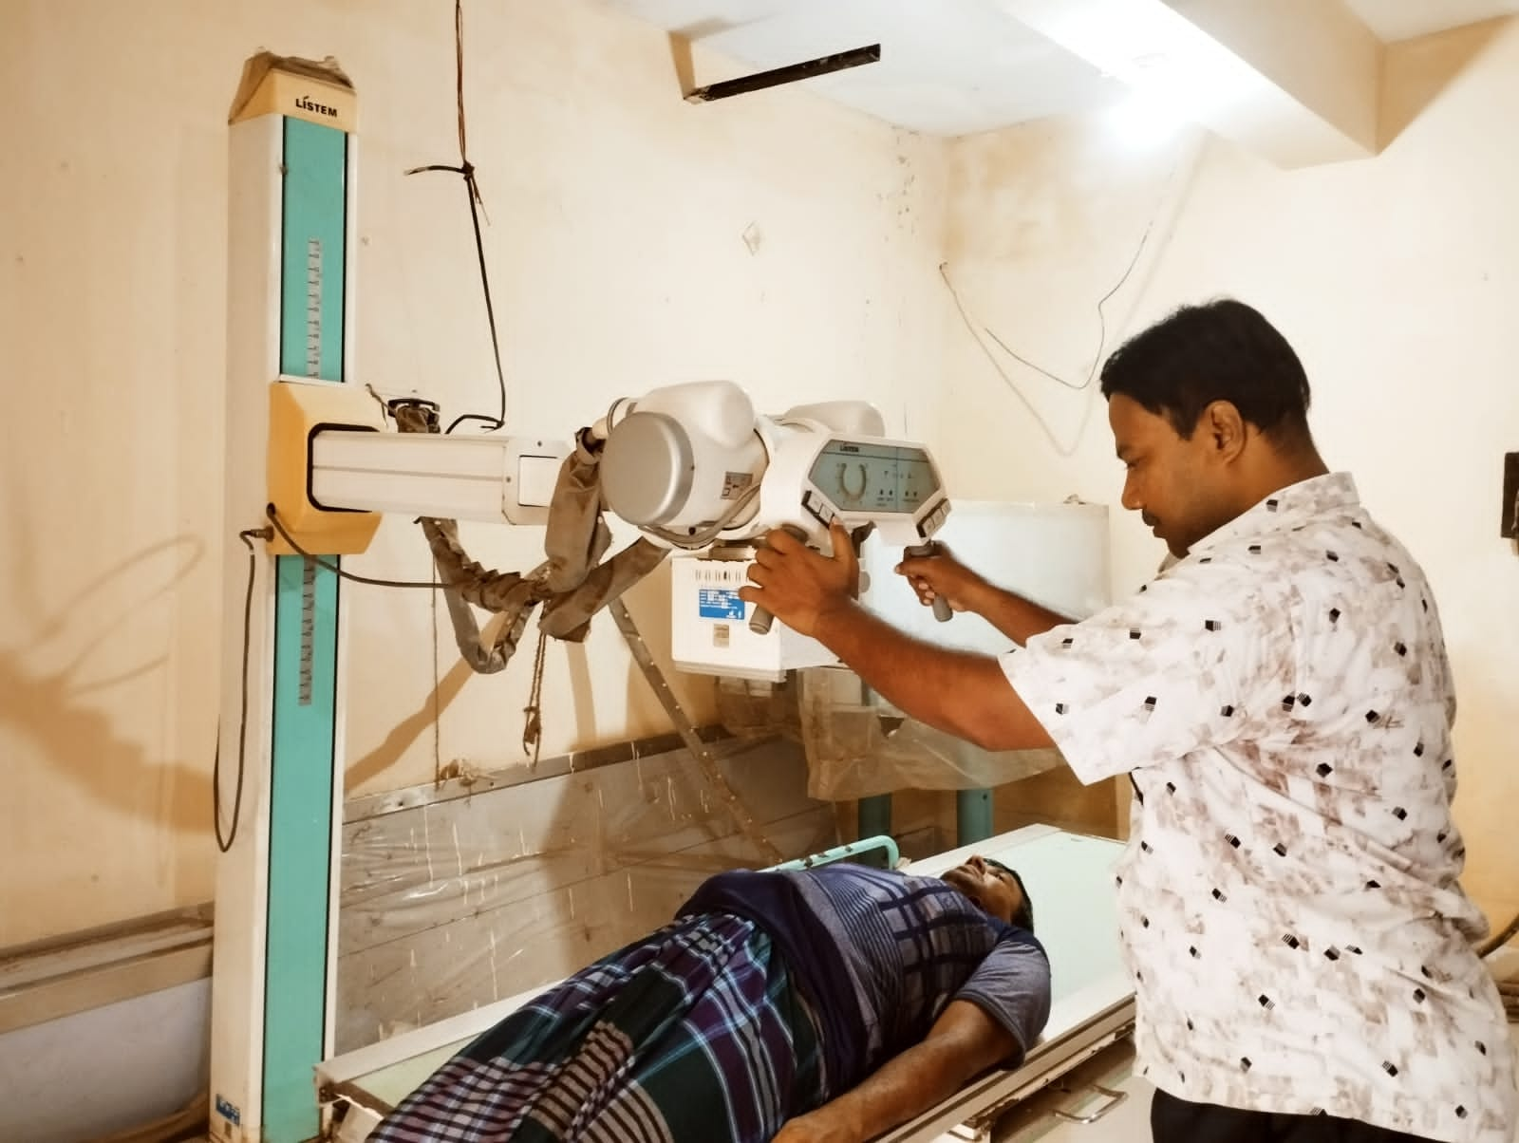
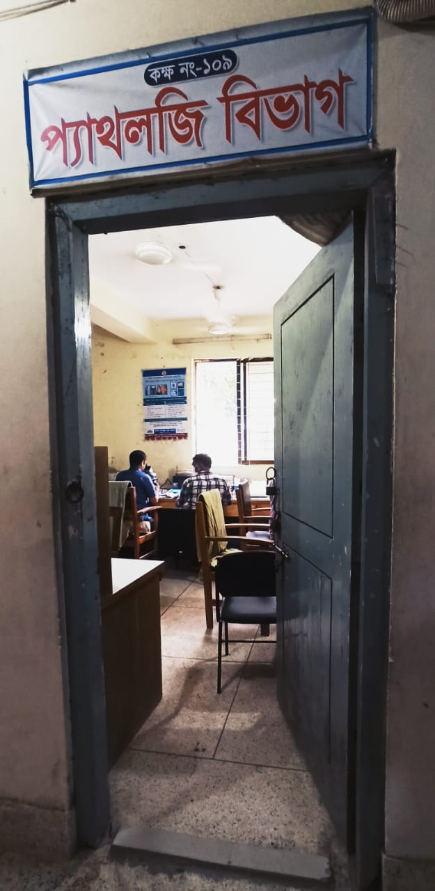
Diagnostic Services
USG
X-ray
Please add photo of ECG
Pathology

Slide 15
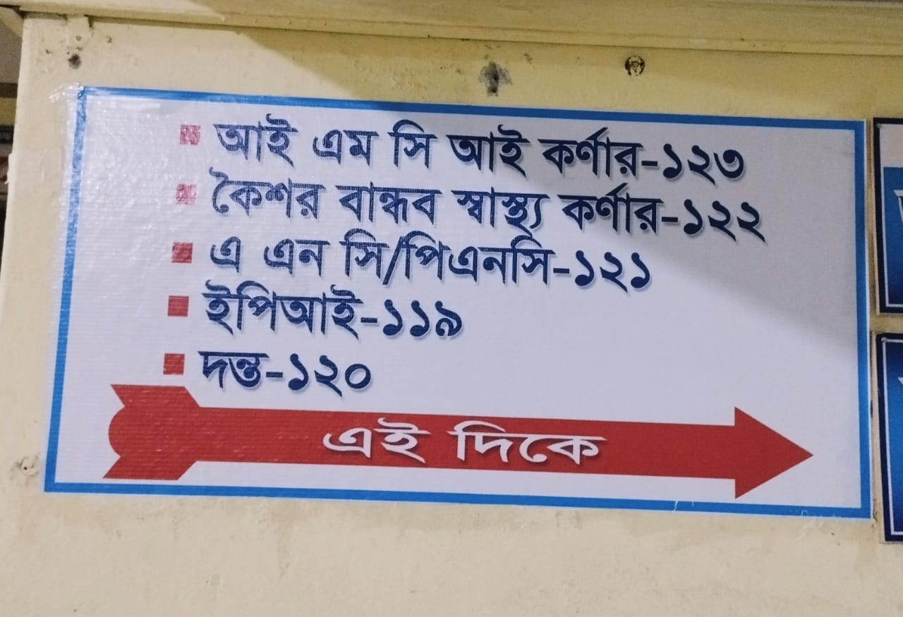
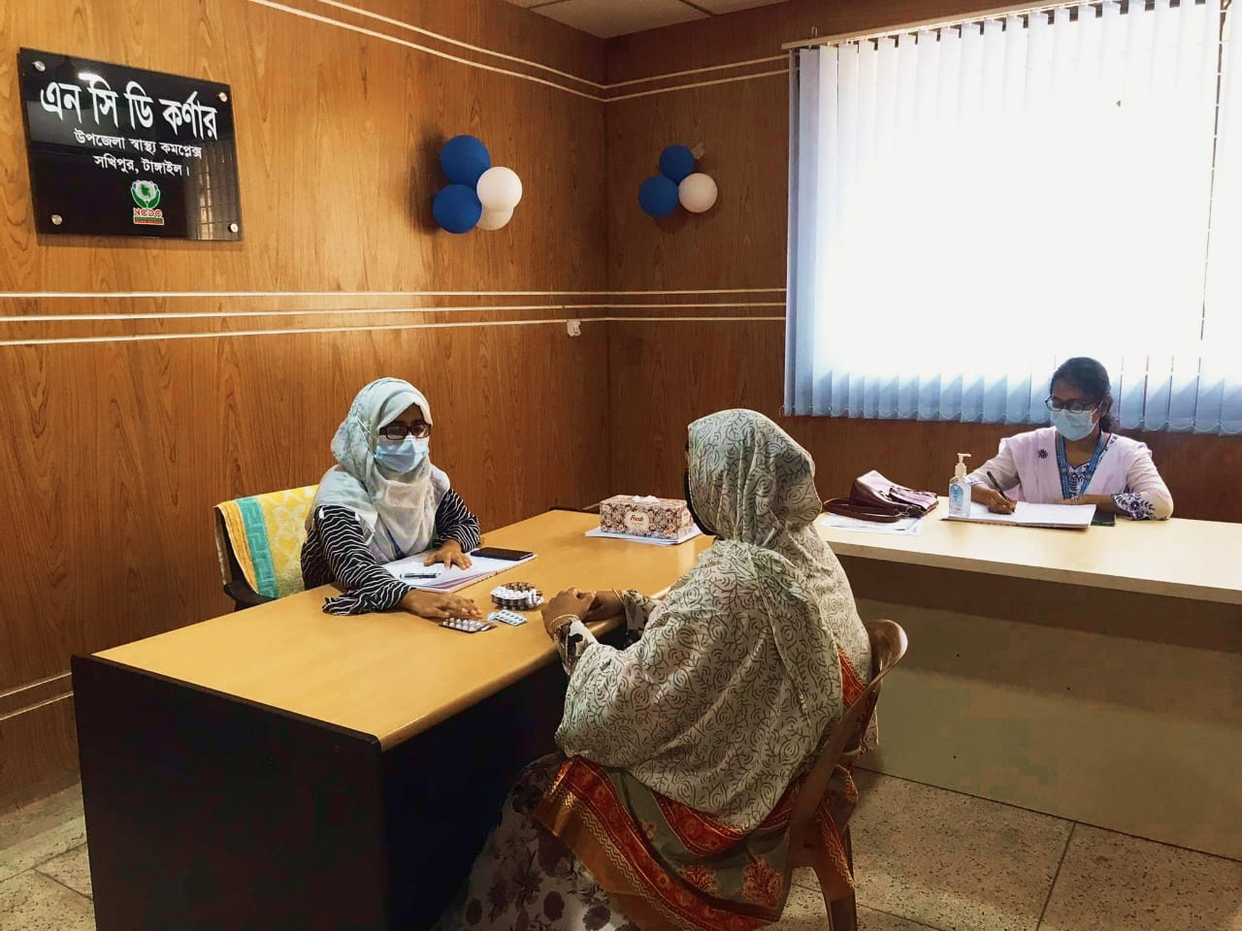
NCD corner
Direction Sign
NCD Corner

Slide 16
NCD corner
Please add photo
SSK Booth
SSK Pharmacy
Please add photo

Slide 17
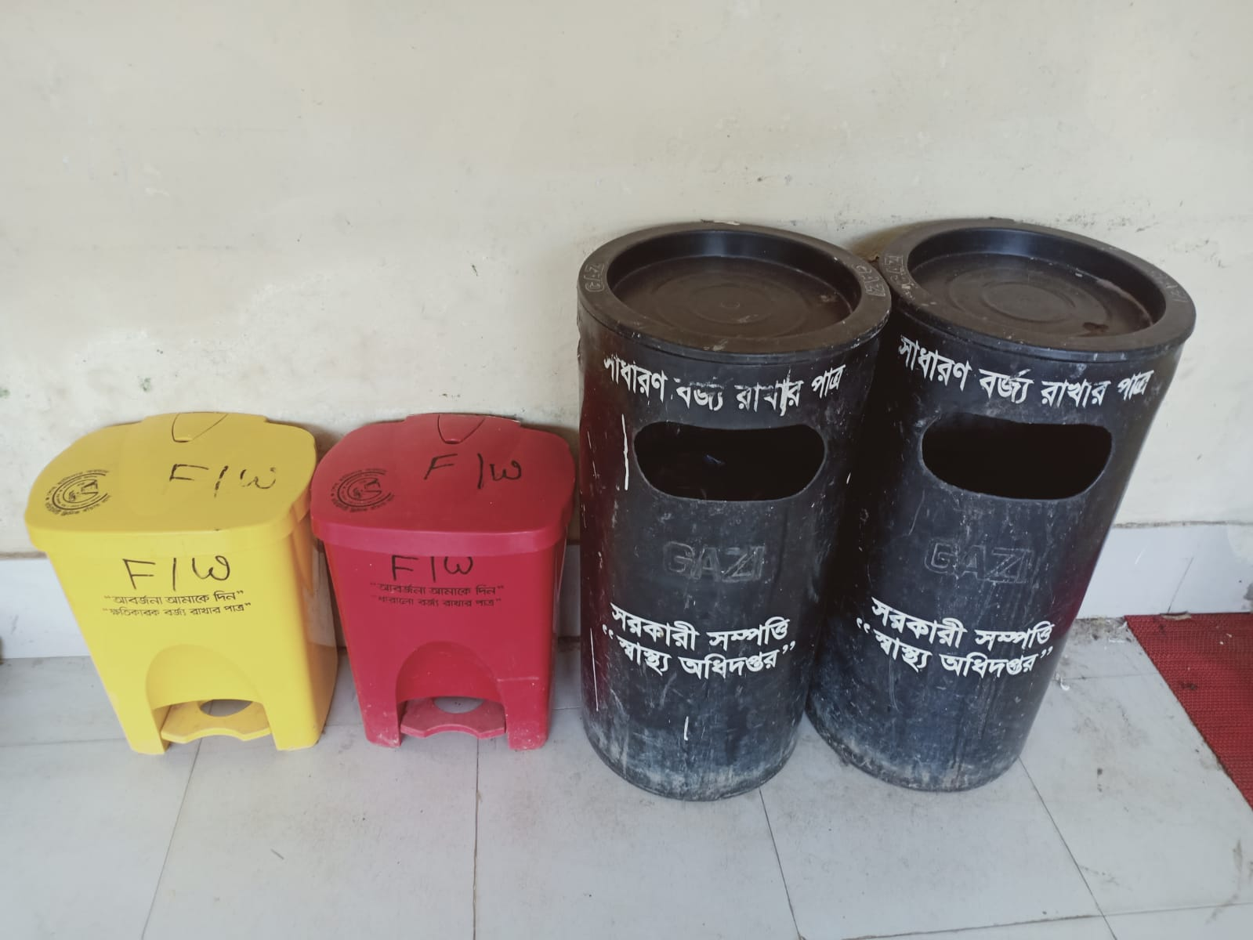
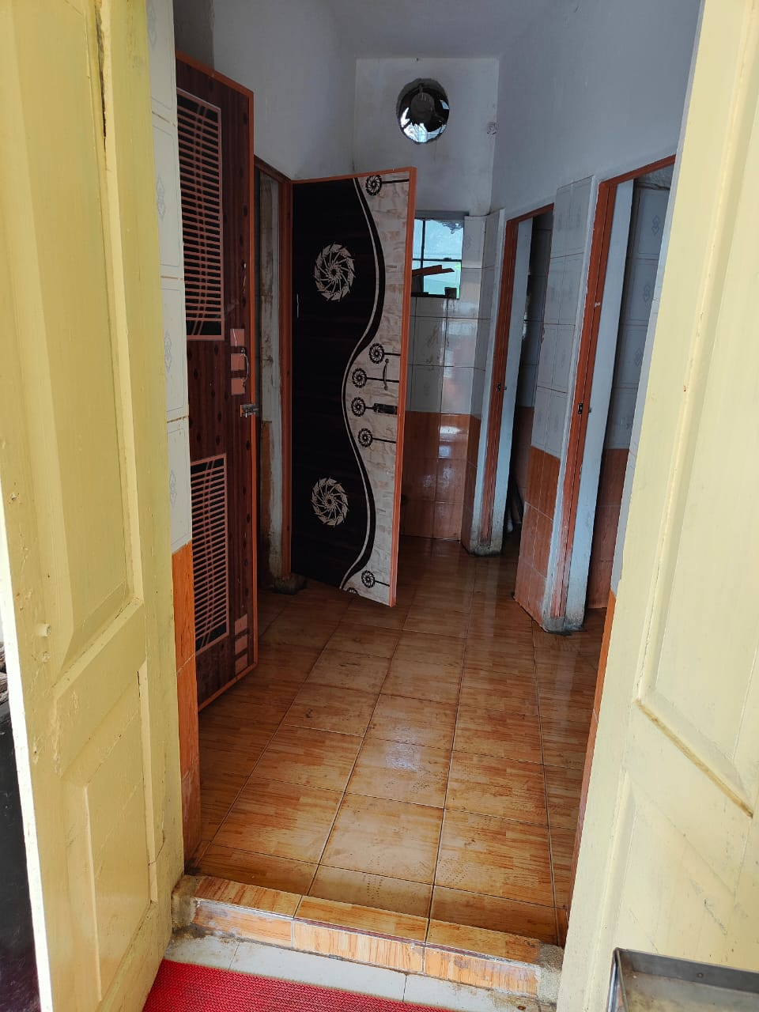
Cleanliness of Washroom and Use of Bin for Waste management
Using Colored Bin for Waste management
Clean Washroom

Slide 18
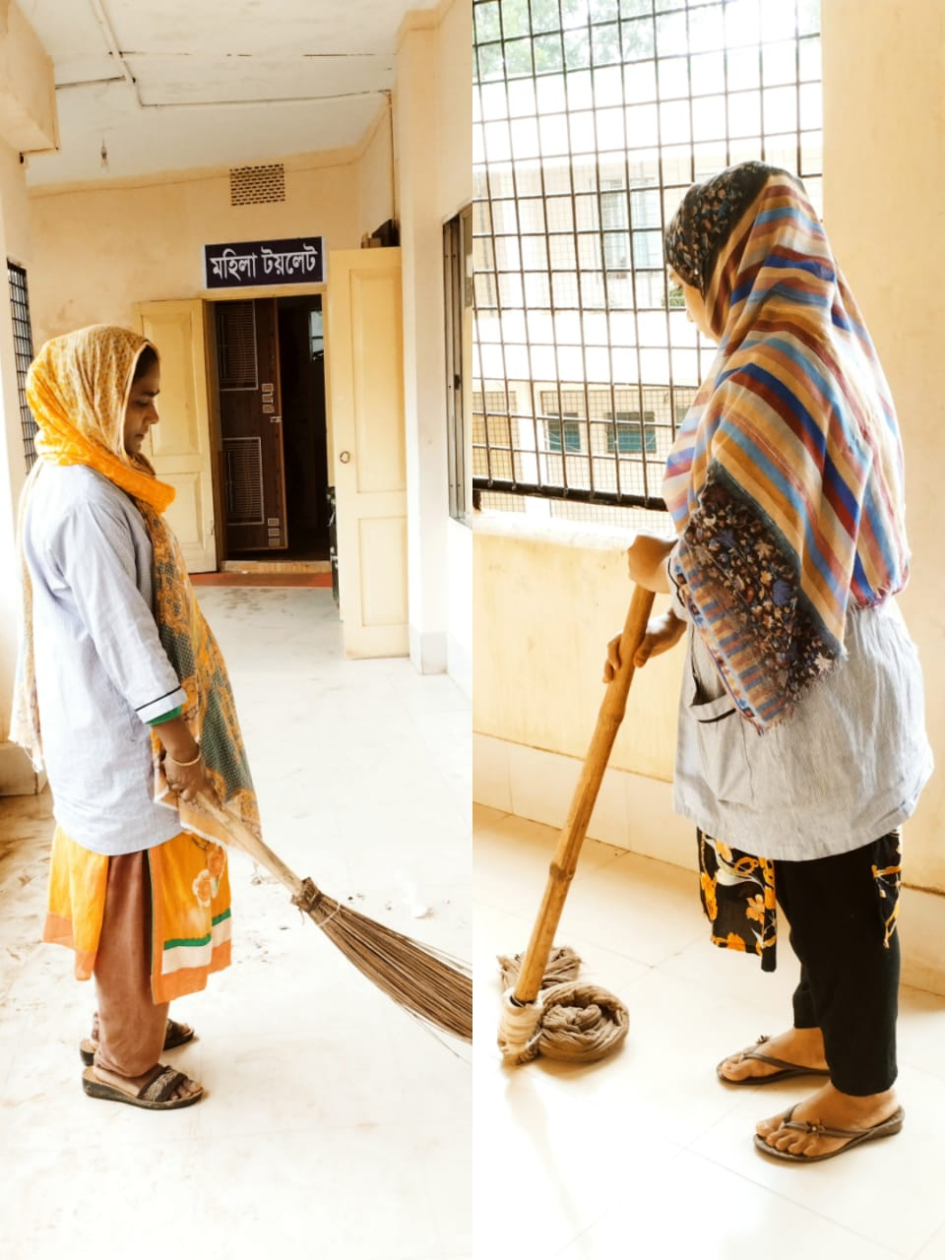
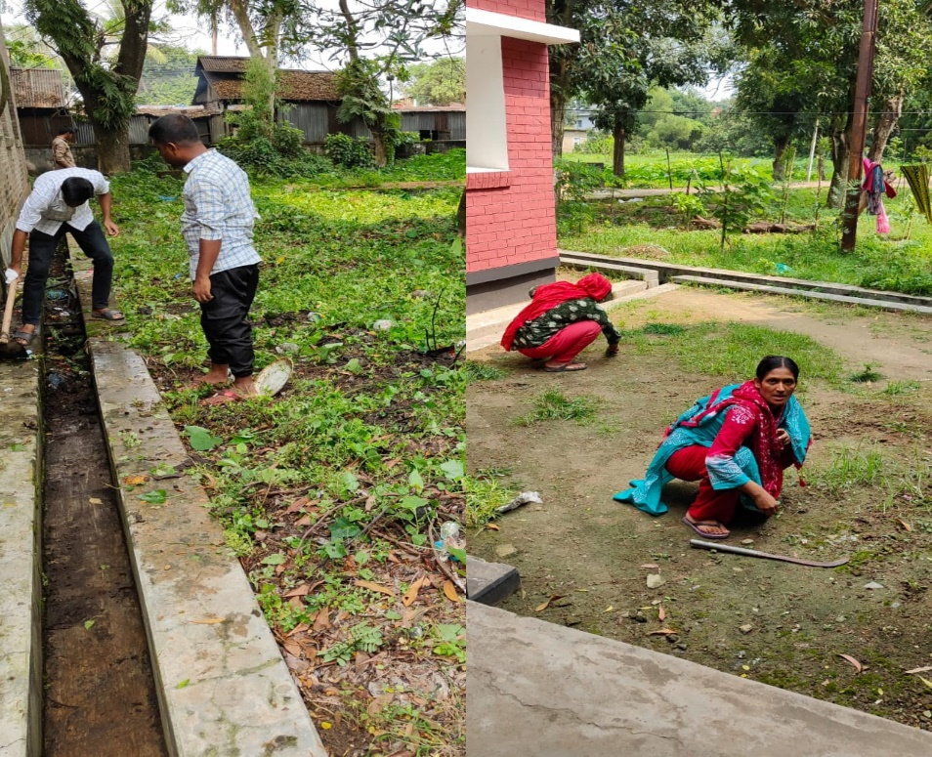
Cleanliness Activities of
UHC Corridor and Campus
Cleanliness activity of hospital corridor
Cleanliness activity of hospital campus

Slide 19
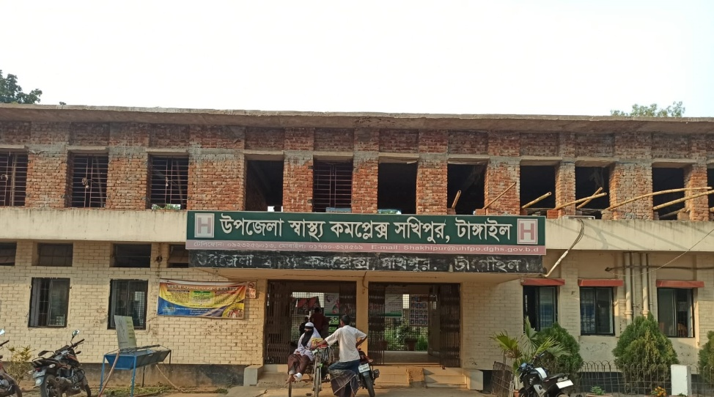
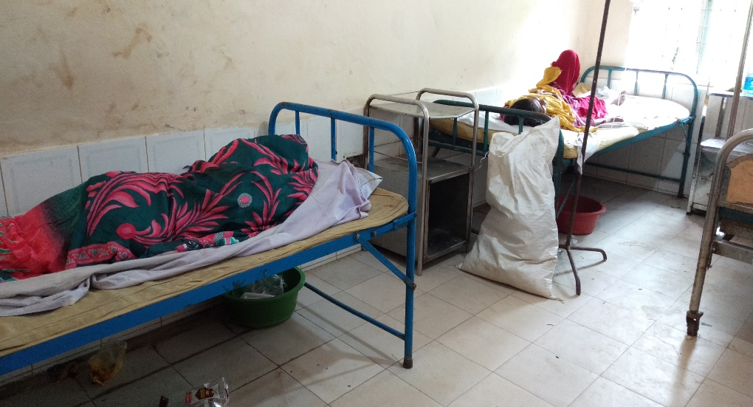

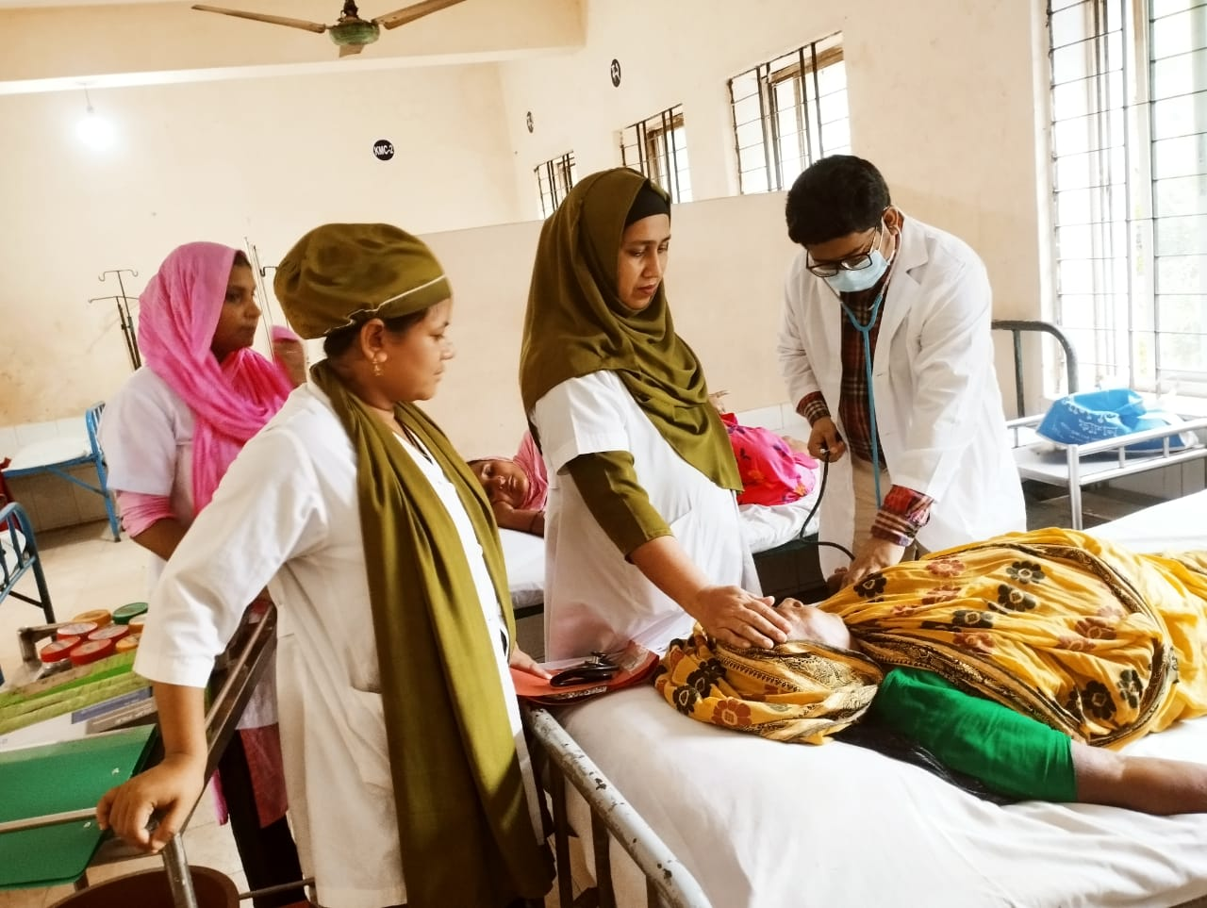


Changes in the hospital building and indoor
BEFORE
AFTER
BEFORE
AFTER

Slide 20
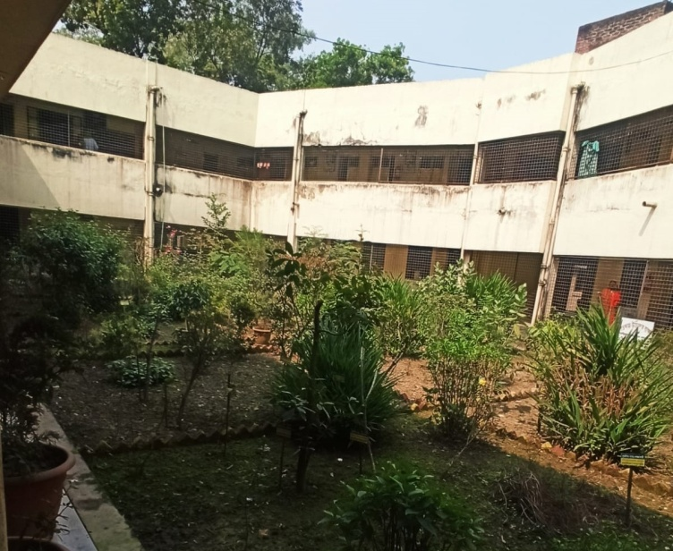
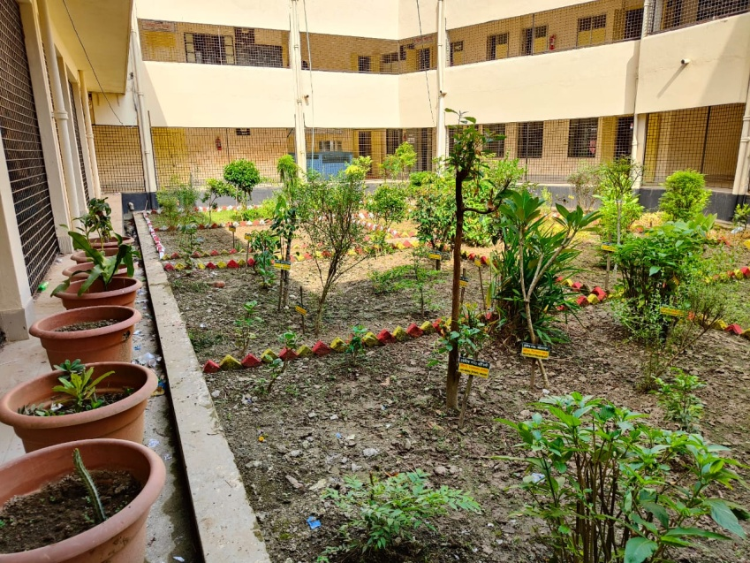
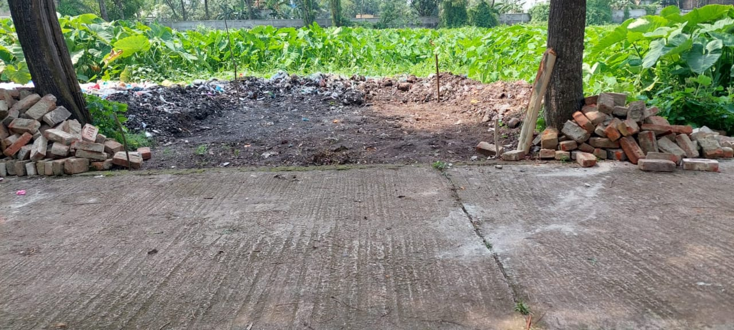
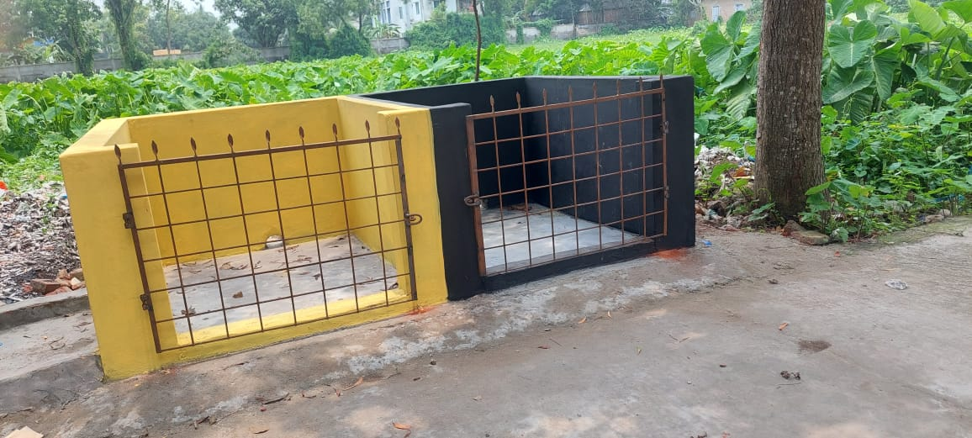
Changes in Garden and Waste management system
BEFORE
AFTER
BEFORE
AFTER

Slide 21
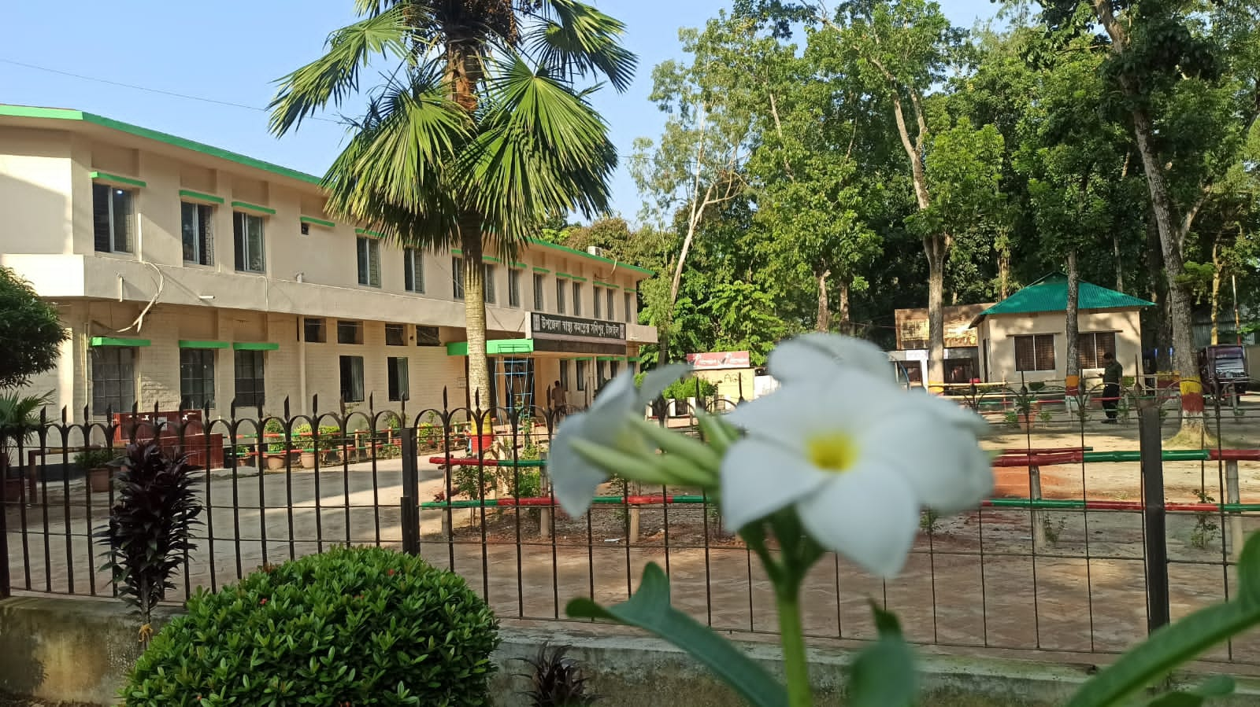
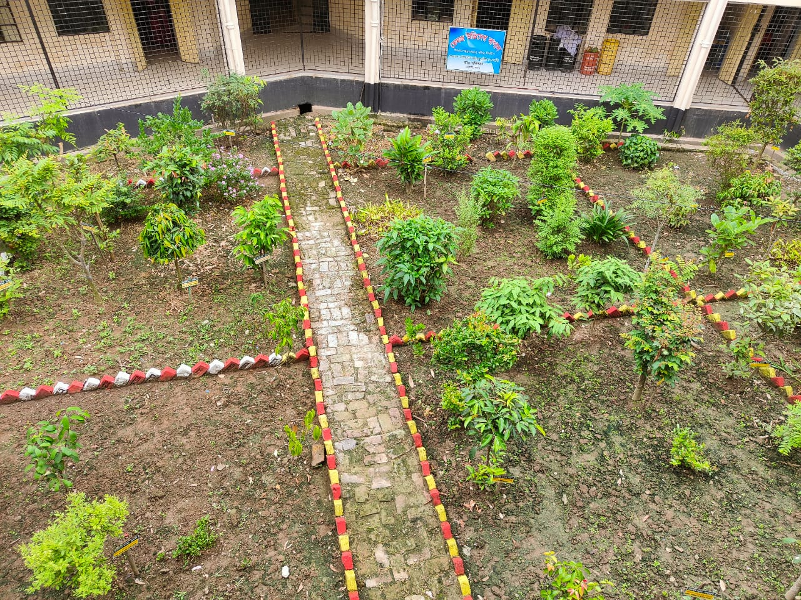
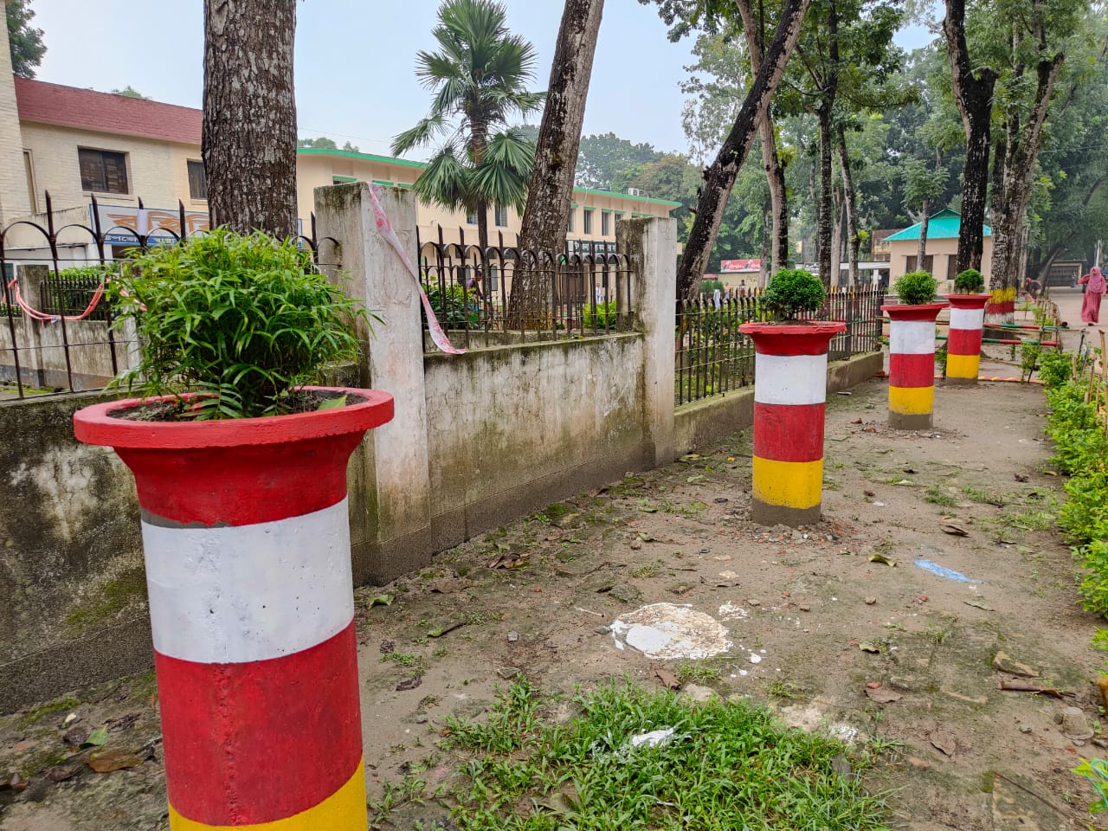
Beautiful Hospital Environment

Slide 22
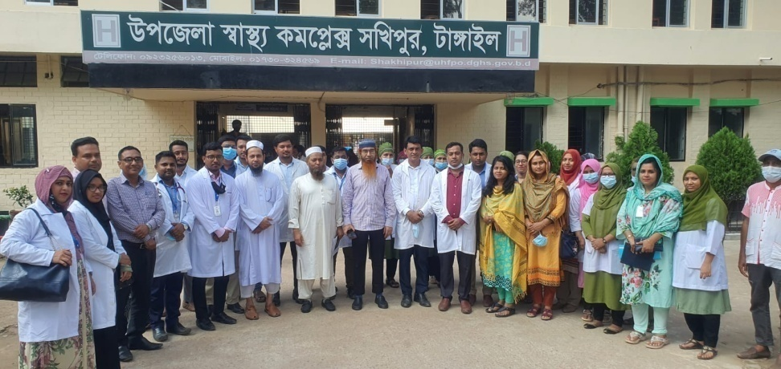
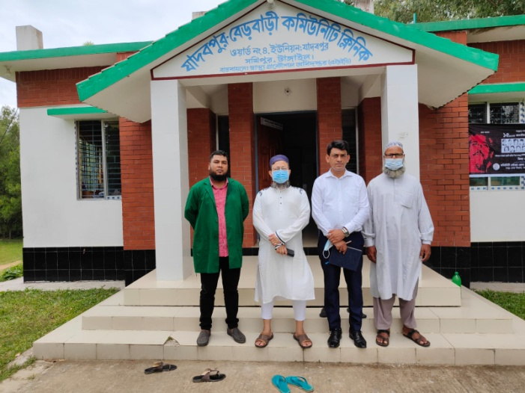
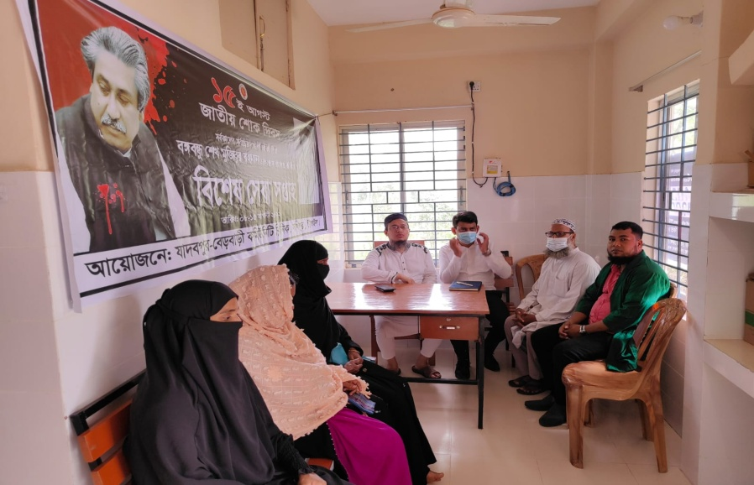
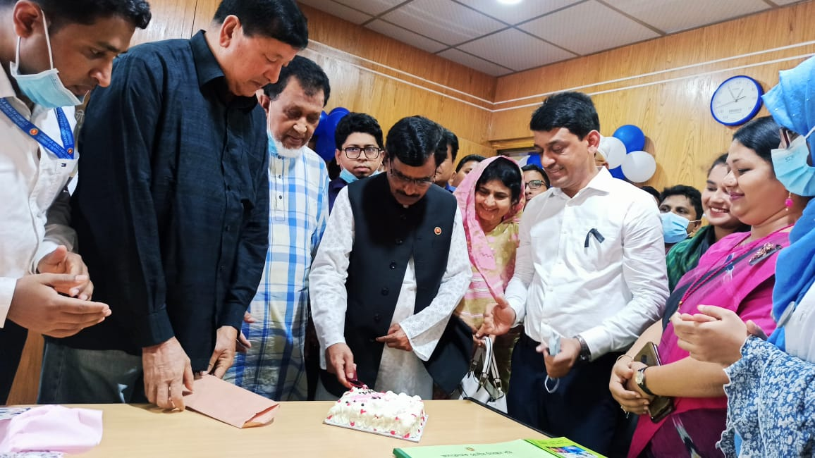
VISIT (select two photos according to importance and mention details)

Slide 23
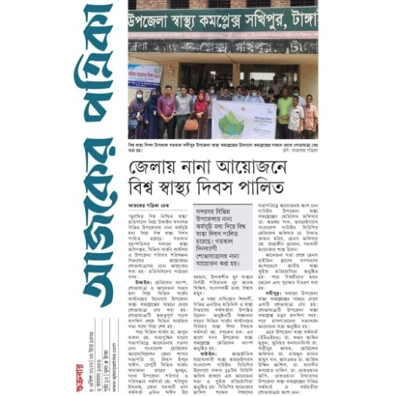
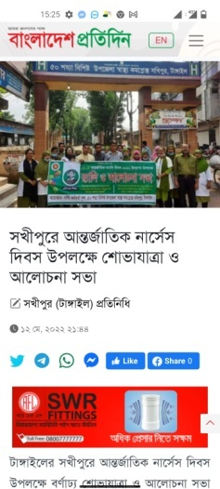
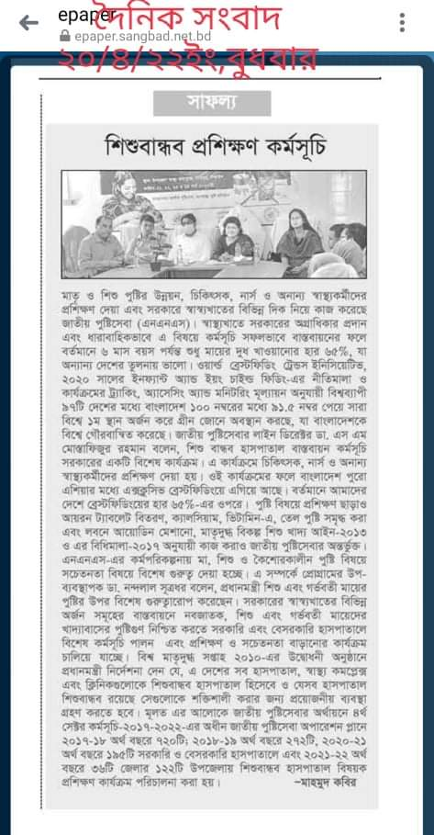
Newspaper Publication

Slide 24
Upazila Health Complex
Shakhipur,Tangail
Community Support
Breast feeding corner donated by JICA , Upazila Parishad.
Waiting chair for Patients, Wheel chair donated from Upazila Parishad.

Slide 25
Achievement of Shakhipur Health Complex
Shakhipur Health Complex became first In HSS Scoring in 2019 .
Shakhipur Health Complex is awarded for best performance in VIA test in 2021.
Beautiful Hospital campus

Slide 26
Challenges
Limited human resource
No cycle stand close to the main gate
Weak birth and death recording system
Weak health education system
Lack of safe drinking water supply for the patients.

Slide 27
Way Forward…
  Successful Implementation of SSK program
  24/7 C-section services.
  Maintain 500 Blood donor list
  HSS position below 100 within 3 months.

Slide 28

Notes:
28

